Slide 1
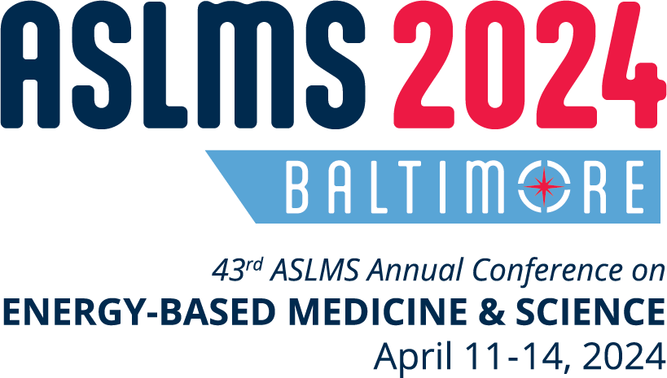
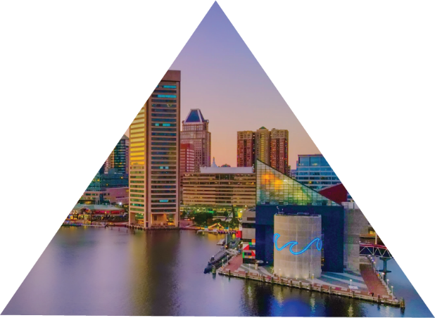
Join innovative clinicians and scientists from around the world in Baltimore, Maryland, at the premier international meeting in the field of medical lasers and energy-based technologies.
^{CONFERENCE FEATURES}
^{KEY DATES}
Pre-Conference Courses
Continuing Education Credits
Industry Sessions
Workshops
Abstract Sessions
Daily Plenary Sessions
Special Events
Evening Receptions
Exhibit Hall
Call for Abstracts| SEP 8 – NOV 6, 2023
Registration Opens| DEC 7, 2023
Pre-Conference | APR 10, 2024
Conference | APR 11-14, 2024
Exhibits | APR 12-13, 2024
LEARN FROM THE WORLD’S LEADING EXPERTS ABOUT:
Body Contouring
Combining Injectables with Devices
Complications and Legal Issues
Dental
Face and Body Lifting/Tightening
Imaging
Hair Growth
Hair Removal
Laser Safety
Laser-Assisted Drug Delivery
Pediatrics
Photobiomodulation
Photodynamic Therapy
Pigmented Lesions
Plastic Surgery
Practice Management
Rejuvenation
Resurfacing
Scar Treatment
Skin Cancer
Skin of Color
Skin Tightening
Social Media
Tattoo Removal
Vascular
Women’s Health
^{LEARN MORE | ASLMS.ORG}

