Slide 1
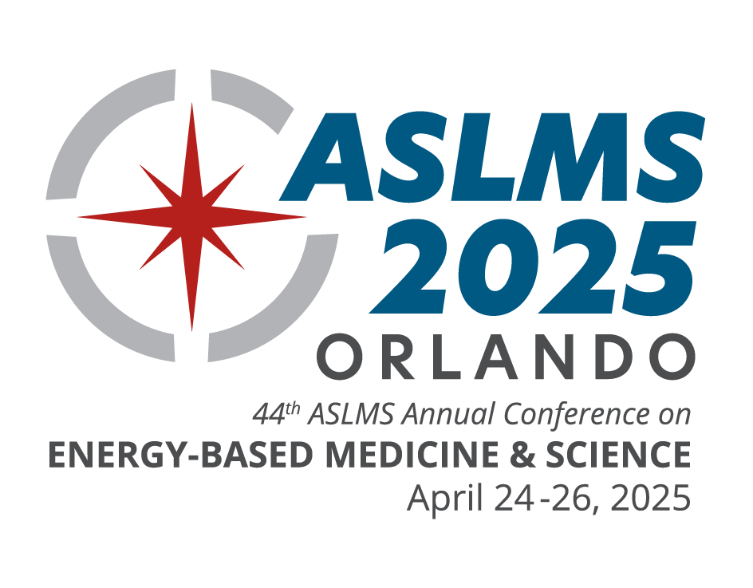
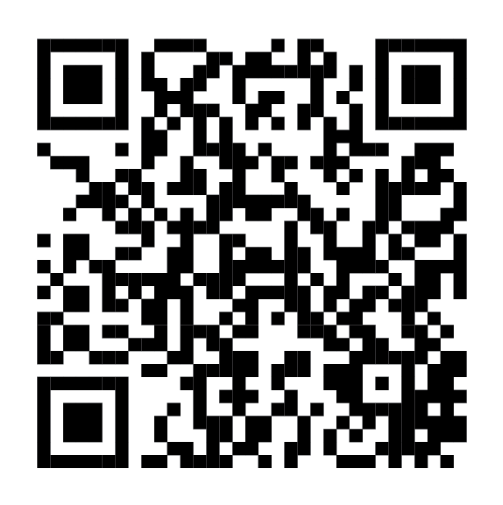
^{CONFERENCE FEATURES}
Pre-Conference Courses
Continuing Education Credits
Industry Sessions
Workshops
Abstract Sessions
Daily Plenary Sessions
Special Events
Evening Receptions
Exhibit Hall
^{KEY DATES}
Join innovative clinicians and scientists from around the world in Orlando, Florida, at the premier international meeting in the field of medical lasers and energy-based technologies.
Pre-Conference | APR 23, 2025
Conference | APR 24-26, 2025
Exhibits | APR 25-26, 2025
ASLMS members save on registration!
^{JOIN TODAY! | ASLMS.ORG/JOIN}
LEARN FROM THE WORLD’S LEADING EXPERTS ABOUT:
Body Contouring
Combining Injectables with Devices
Complications and Legal Issues
Dental
Face and Body Lifting/Tightening
Imaging
Hair Growth
Laser Safety
Laser-Assisted Drug Delivery
Pediatrics
Photobiomodulation
Photodynamic Therapy
Pigmented Lesions
Practice Management
Rejuvenation
Resurfacing
Scar Treatment
Skin Cancer
Skin of Color
Social Media
Tattoo Removal
Vascular
Women’s Health
& More!
^{LEARN MORE | ASLMS.ORG}

