Slide 1

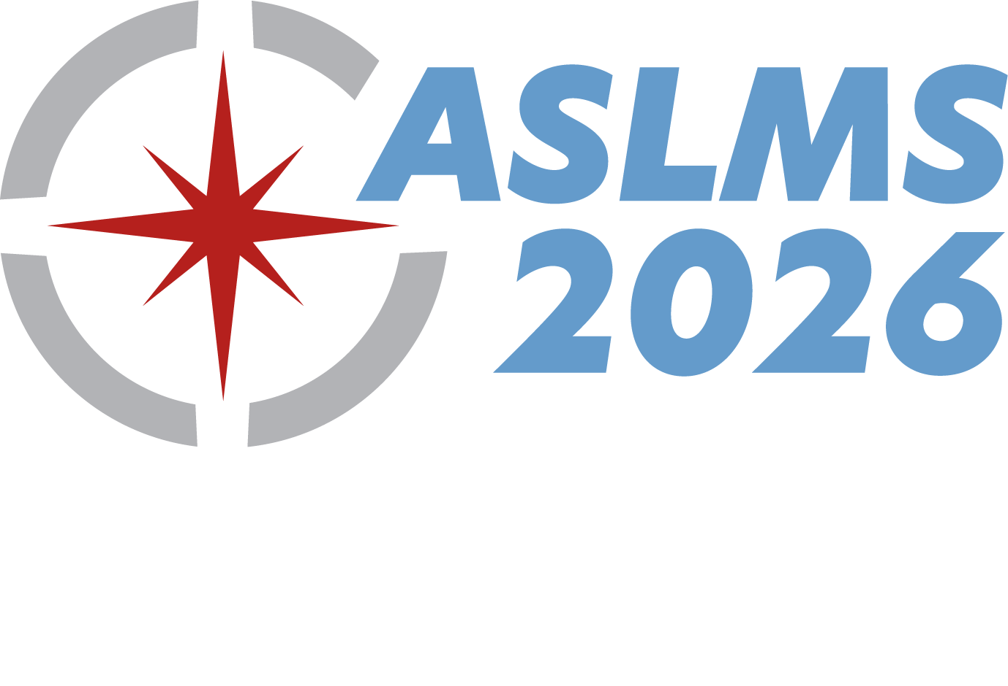
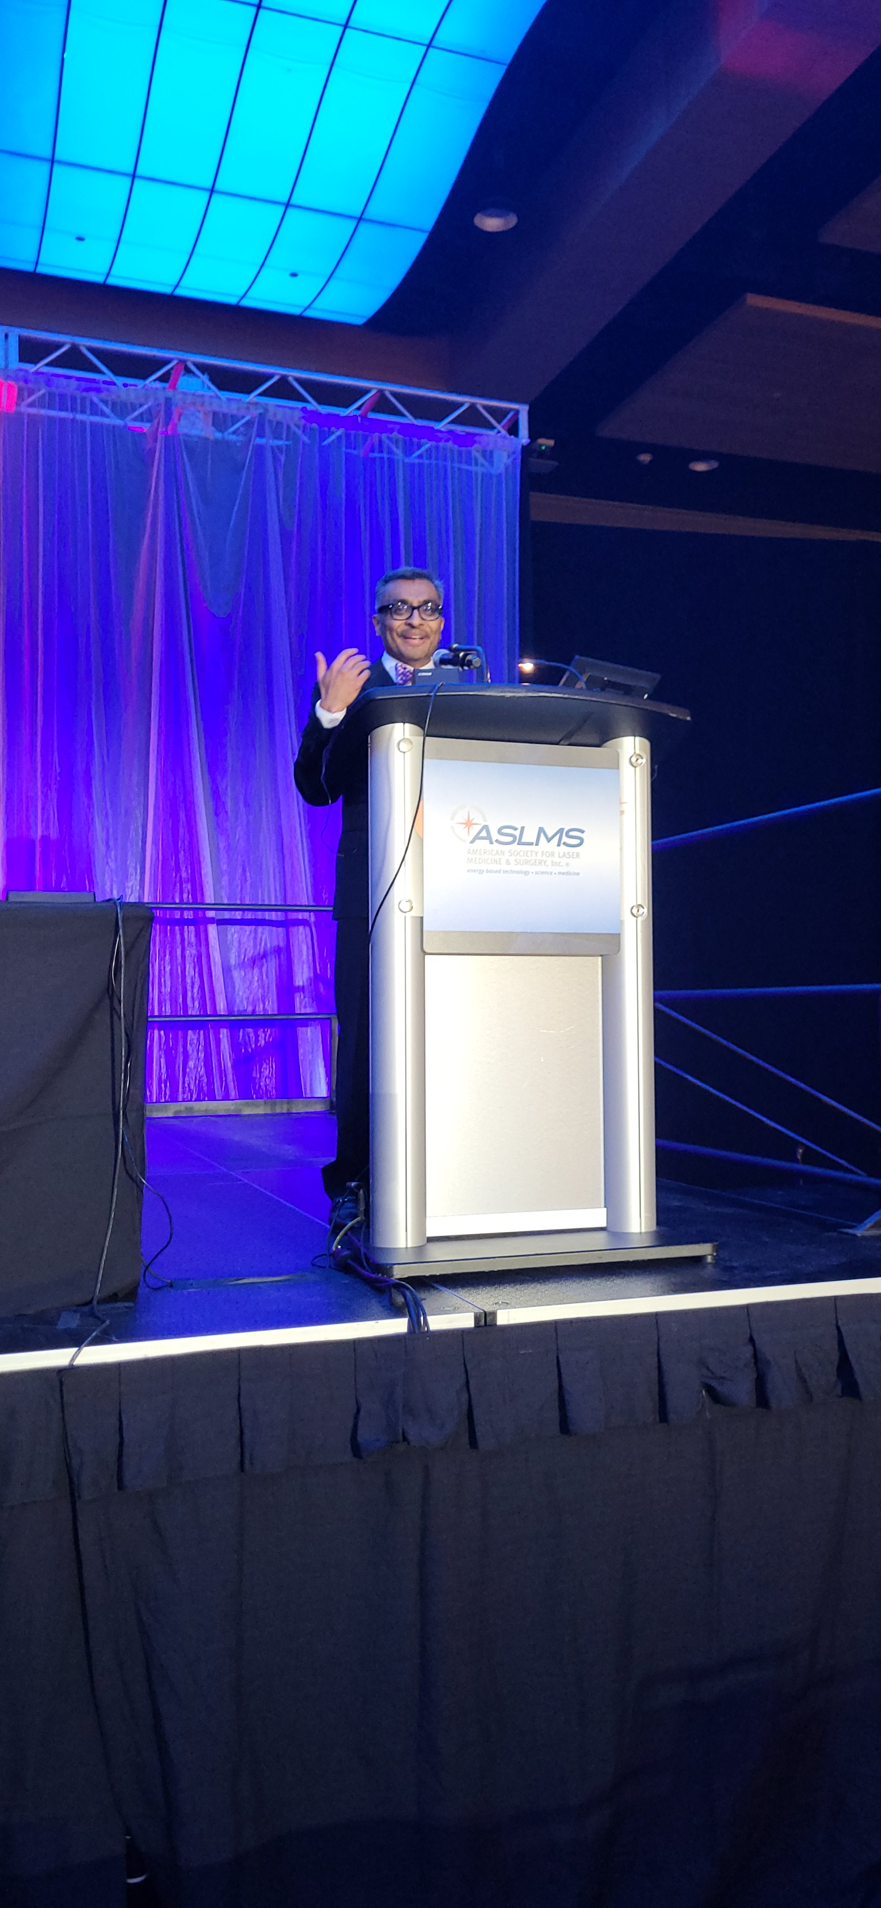
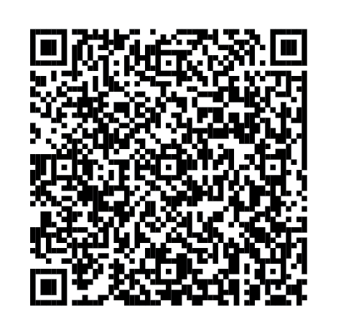
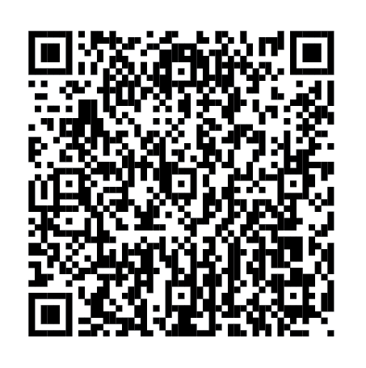
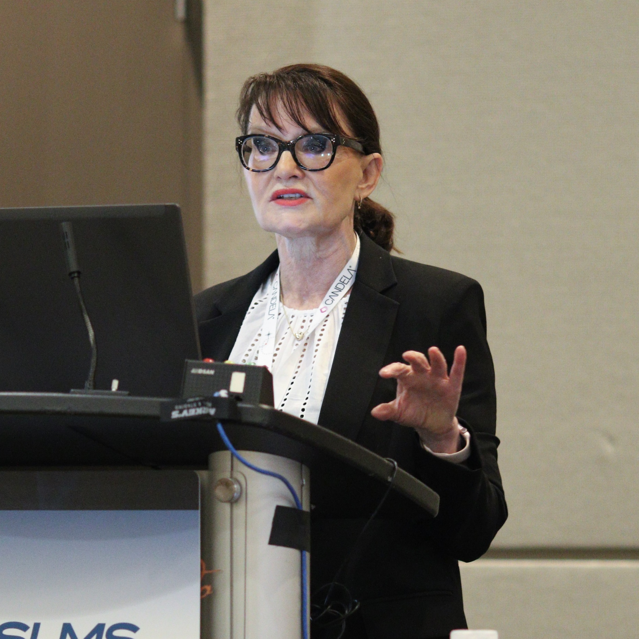
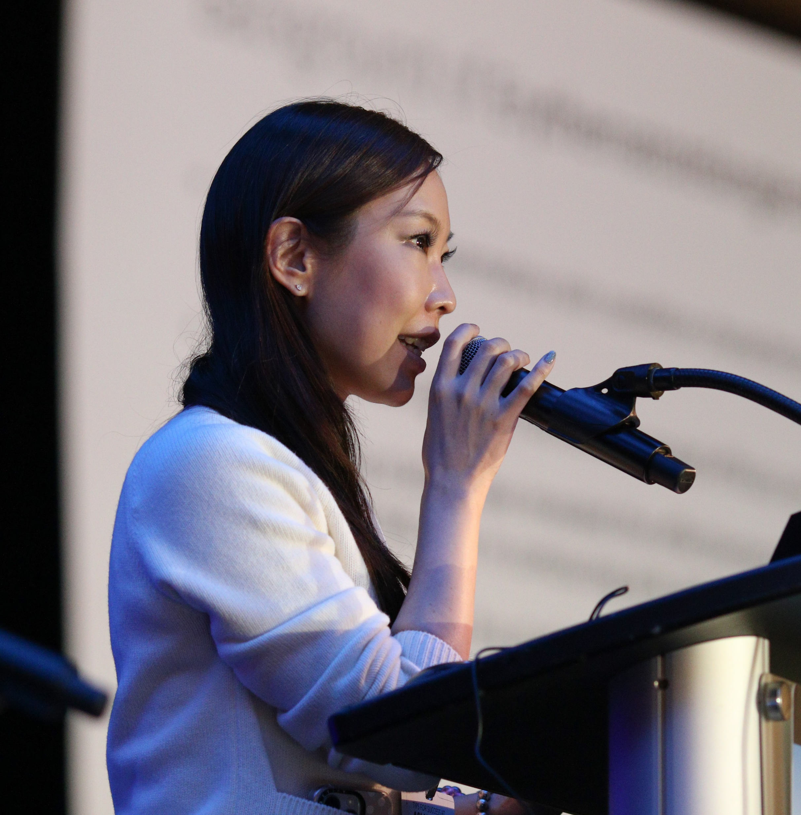
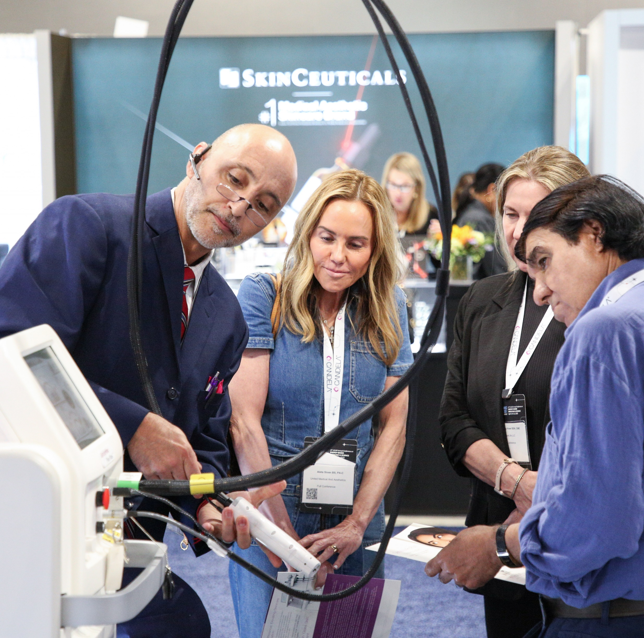
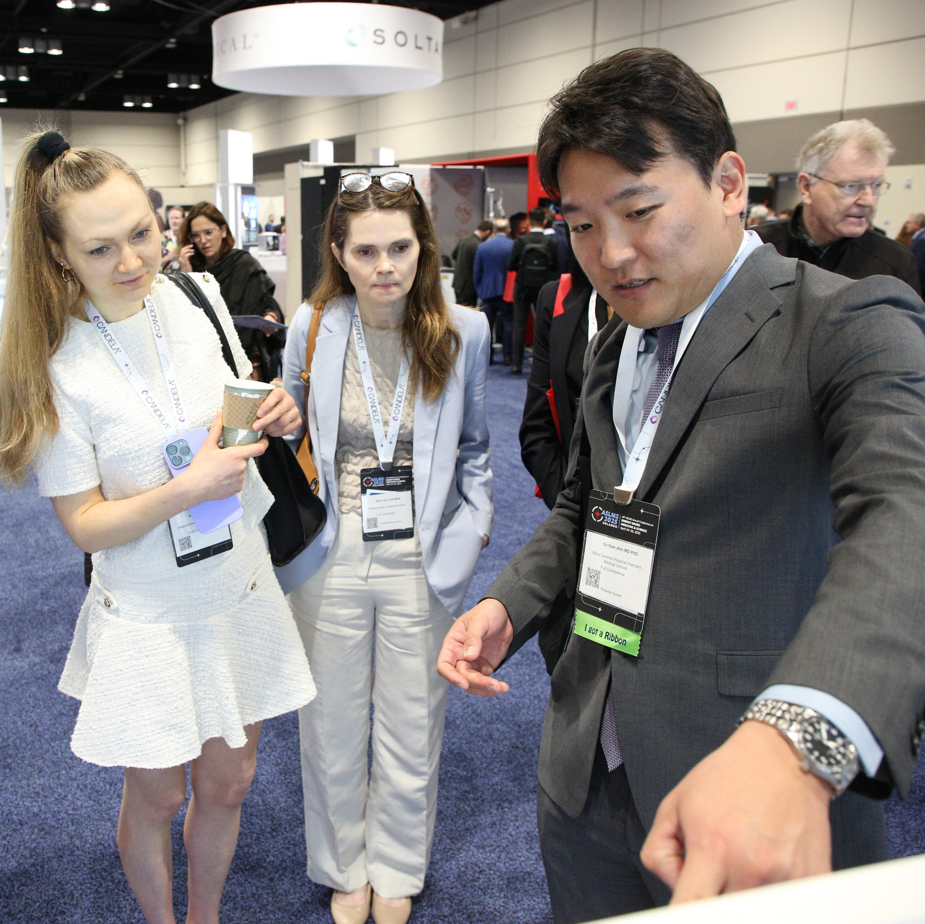

Join innovative clinicians and scientists from around
the world in Savannah, Georgia, at the premier
international meeting in the field of medical lasers
and energy-based technologies.
Members save on registration!
^{LEARN MORE}
^{ASLMS.ORG}
^{JOIN TODAY!}
^{ASLMS.ORG/JOIN}
^{CONFERENCE FEATURES}
^{KEY DATES}
Pre-Conference Courses
Continuing Education Credits
Industry Sessions
Workshops
Abstract Sessions
Daily Plenary Sessions
Special Events
Evening Receptions
Exhibit Hall
Call for Abstracts | SEP 17 - DEC 10, 2025
Pre-Conference | MAY 6, 2026
Conference | MAY 7-9, 2026
Exhibits | MAY 8-9, 2026
LEARN FROM THE WORLD’S LEADING EXPERTS ABOUT:
Ablative and Non-Ablative Lasers
AI in Aesthetics
Body Contouring
Challenging Cases
Combining Modalities
Global Aesthetics
Hair Restoration
Laser Safety
Laser Physics
Laser-Assisted Drug Delivery
LLLT/Photobiomodulation
Optimizing Outcomes
Periorbital Rejuvenation
Picosecond Lasers
Pigmented Lesions
Practice Management
Radiofrequency
Regenerative Medicine
Rejuvenation
Scar Treatment
Skin Cancer
Skin of Color
Social Media
Tattoos
Ultrasound
Vascular
& More!

