Slide 1
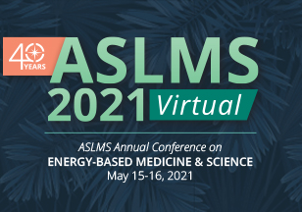
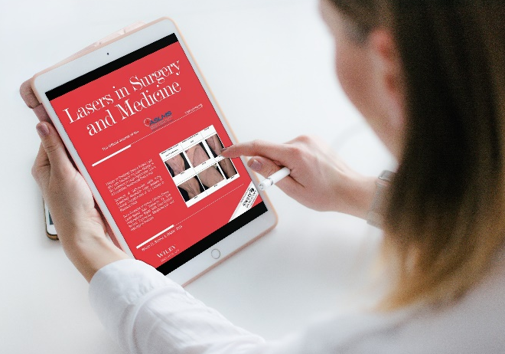
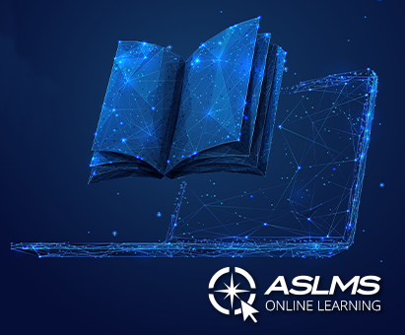
ANNUAL CONFERENCE
The largest conference on laser and related technologies for medicine held in the United States.
The go-to meeting for cutting-edge research and the multidisciplinary exchange of ideas.
Members receive discounted registration fees.
The world’s largest professional organization dedicated to promoting
excellence in patient care through the safe and effective use of lasers and other energy-based technologies.
LSM JOURNAL
Members receive:
FREE online subscription to the Society’s scientific and clinical journal, Lasers in Surgery and Medicine (LSM).
Access to the LSM Journal Club held each month.
ONLINE LEARNING
Access courses, live and recorded webinars, pre-recorded presentations plus video and podcast interviews.
ASLMS members receive discounted rates for courses and webinars plus access to exclusive free members-only content.
Don’t miss the 2021 Fundamentals of Lasers and Energy-Based Devices in Healthcare 10-part series.
JOIN TODAY!
aslms.org

Slide 2
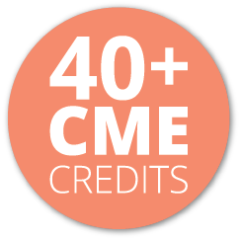
LEARN from the world’s leading experts who will share their latest advances for patient care.
Join innovative clinicians and scientists from around the world at the premier international meeting in the field of medical lasers and energy-based technologies.
^{One registration fee provides}
access to all live plus on-demand
sessions. Registration provides
^{access to the conference}
^{on-demand content until}
^{July 15, 2021.}
EXPERIENCE a new virtual program featuring the best of the Annual Conference, with new formats and features.
REGISTER TODAY!
LEARN MORE AT ASLMS.ORG
EXPLORE the virtual Innovations Center to see new technologies and applications that enhance patient care.
GET CONNECTED
#ASLMS2021

