Slide 1
DEVELOPING THE NEXT GENERATION OF ENERGY-BASED TECHNOLOGY LEADERS

Slide 2
The world’s largest professional organization dedicated to promoting excellence in patient care through the safe and effective use of lasers and
other energy-based technologies.

Slide 3
Early Career Opportunities
ASLMS Early Career = Students, residents, fellows and young professionals up to 10 years post-graduation
The ASLMS Early Career Network aims to support those in training and at the start of their professional careers by building relationships and promoting involvement in ASLMS

Slide 4
FREE AND REDUCED MEMBERSHIP DUES
ASLMS offers:
FREE membership for medical students, residents, undergraduate and graduate students, fellows-in-training, and post-doctoral fellows for the duration of their training
Reduced dues for 1st and 2nd year post graduate members

Slide 5
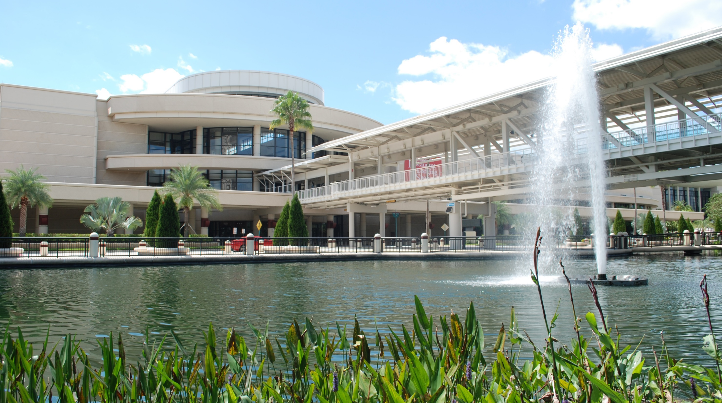
Save the date!
ASLMS 2025 | April 24-26, 2025
Orange County Convention Center | Orlando, Florida
#ASLMS2025

Slide 6
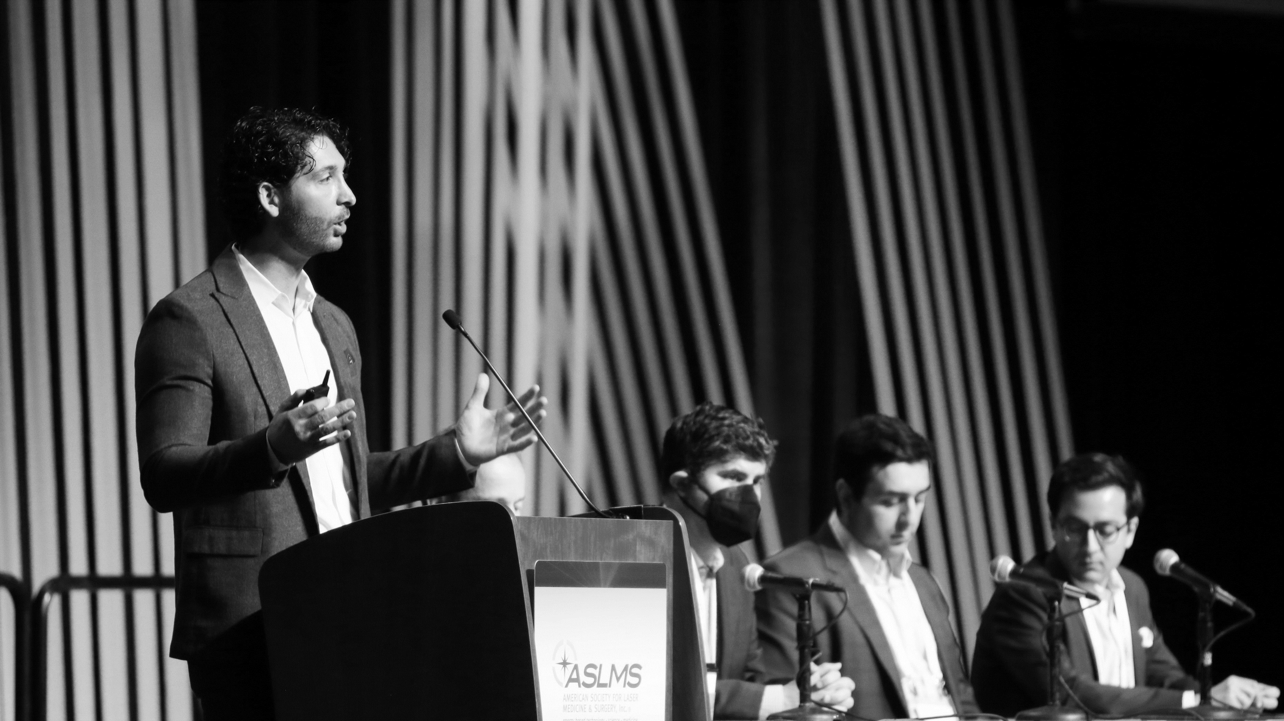
Education
Annual Conference Fees
Reduced conference registration fees for qualifying members
Who Qualifies?
Undergraduate and Graduate Students
Early Career Abstracts
Present your research in Basic Science and Translational Research or Clinical Applications
Who Qualifies?
Students, Residents, Fellows to 10 years Postgraduate

Slide 7
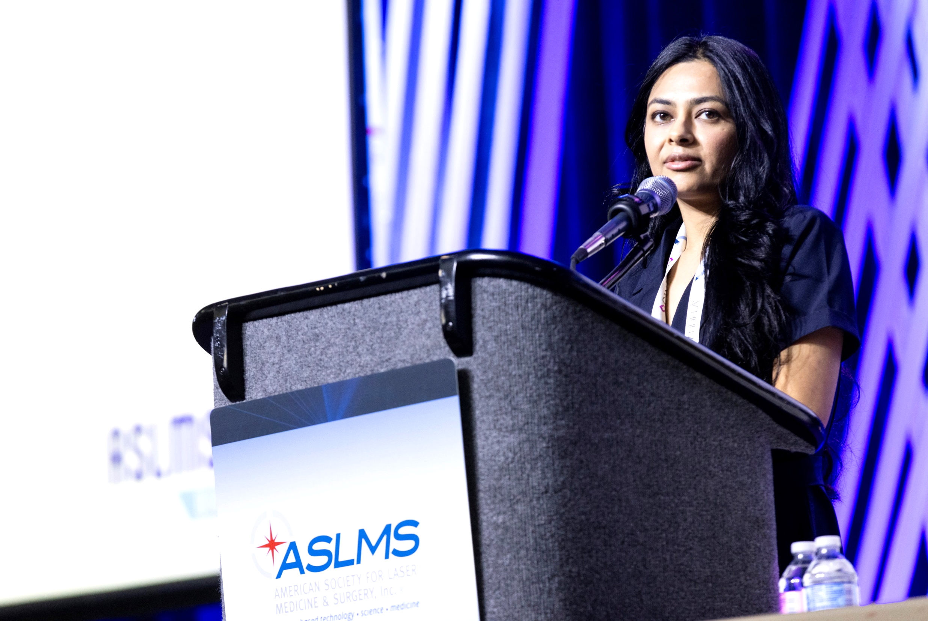
Education
Abstract Presenting
Author Scholarships
Available for select students and medical/research trainees who submit an abstract and are accepted as the presenting author for oral presentation at the Annual Conference
Up to $750 (USD) for qualifying applicants
Who Qualifies?
Medical students, residents, undergraduate students, interns, and fellows-in-training involved in patient-oriented research and graduate students and post-doctoral fellows involved in biomedical laser research.

Slide 8
Education
Early Career Educational Support
ASLMS offers offset registration fees for qualified students, residents, and fellows to attend the conference
Educational support is based on current or previous service to the Society and/or agreement to serve on the ASLMS Host Committee
Undergraduate students, physician students (medical student, intern, enrolled in a current residency program, fellow-in-training doing patient-oriented research), early career scientist students (graduate student or post-doctoral trainee currently involved full-time in biomedical laser research), nursing/allied health students
Who Qualifies?

Slide 9
education
ASLMS Online Learning Center
ASLMS membership provides access to courses, pre-recorded presentations, and more
Many of the offerings are free to ASLMS members
All content is presented by leaders in the field of lasers and energy-based medicine
Introductory courses available for those new to lasers and energy-based devices
Who Qualifies?
All ASLMS Members

Slide 10
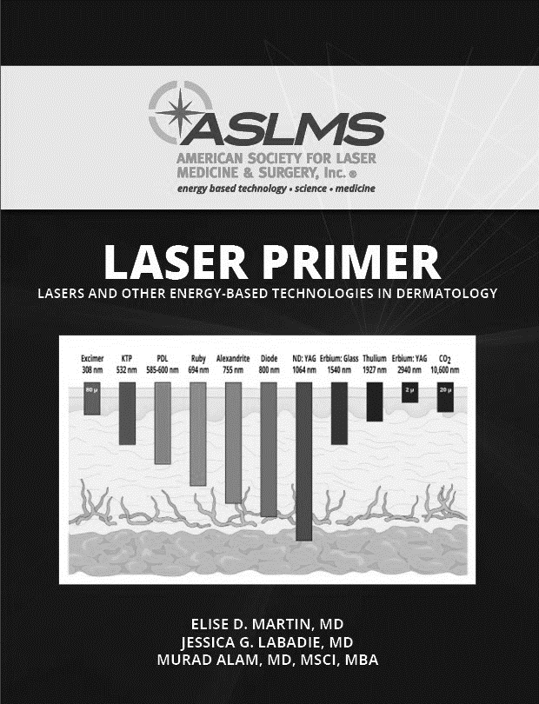
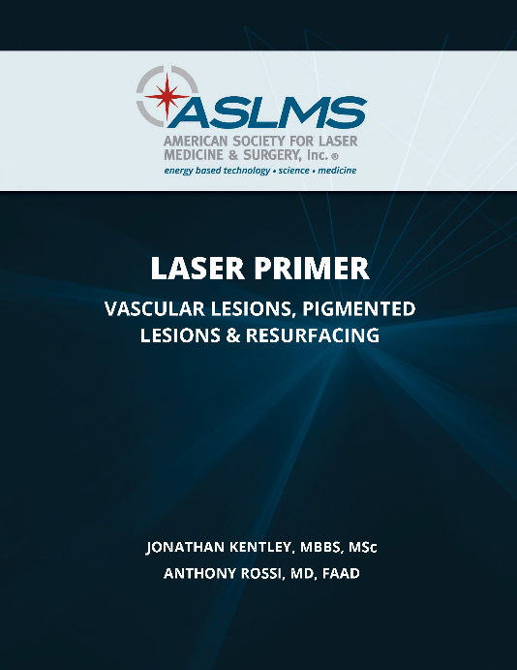
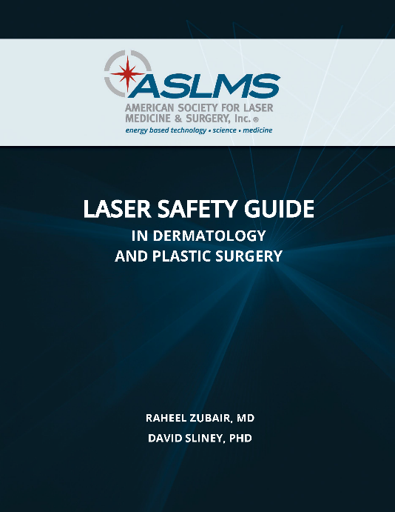
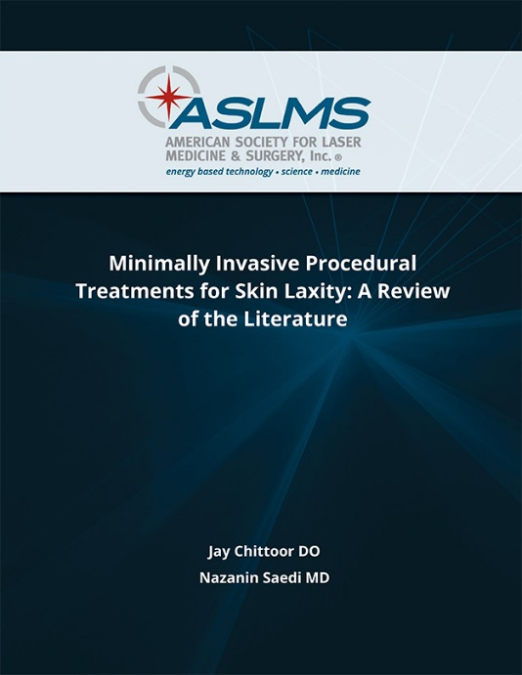
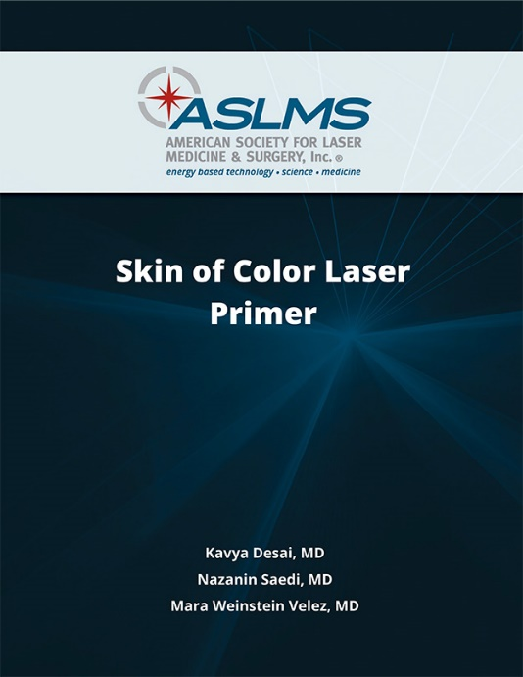
education
Early Career Learning Opportunities
Free resources to help you build a strong foundation in lasers and other light energy-based technology
ASLMS Lasers, Lights, and Energy-Based Devices: 100 Fast Facts and Pearls for Board Review and Clinical Practice
Laser Primer: Lasers and Other Energy-Based Technologies in Dermatology
And more!
Log in to download
Who Qualifies?
All ASLMS Members

Slide 11
Education
ASLMS Mentorship Program
The mentorship program connects residents and early career members with more senior members of our society to work on a specific project over a one-year period and build relationships.
Choose your project
Choose your mentor or ask for one to be assigned to your project
Share results with the ASLMS community
Who Qualifies?
All ASLMS Members

Slide 12
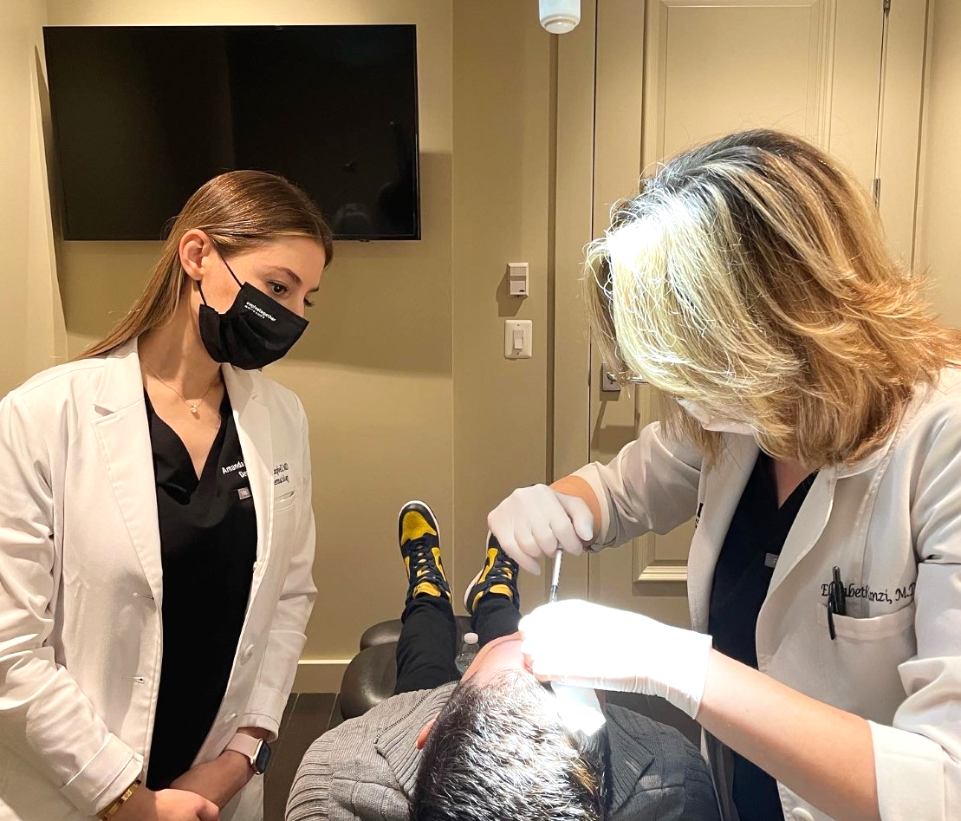
Education
Preceptorship Program
A unique opportunity for ASLMS members who are early in their careers to:
Learn new techniques and perspectives in lasers and other energy-based technologies
Observe a successful practice in action
Develop valuable career networks
ASLMS member who is a third-year resident, in a fellowship, or who is between one and five years post medical school graduation.
Who Qualifies?

Slide 13
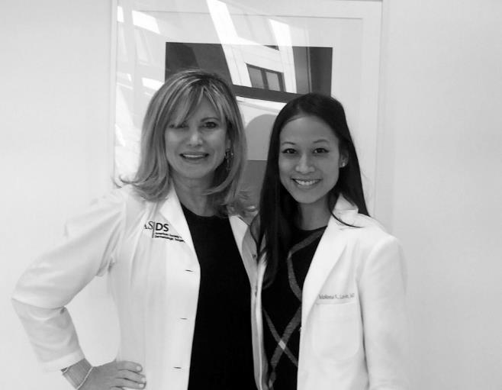
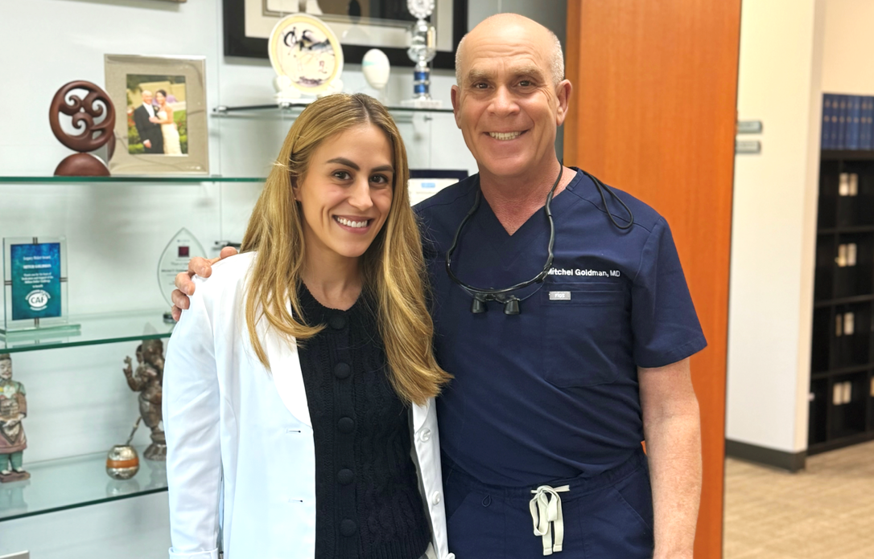
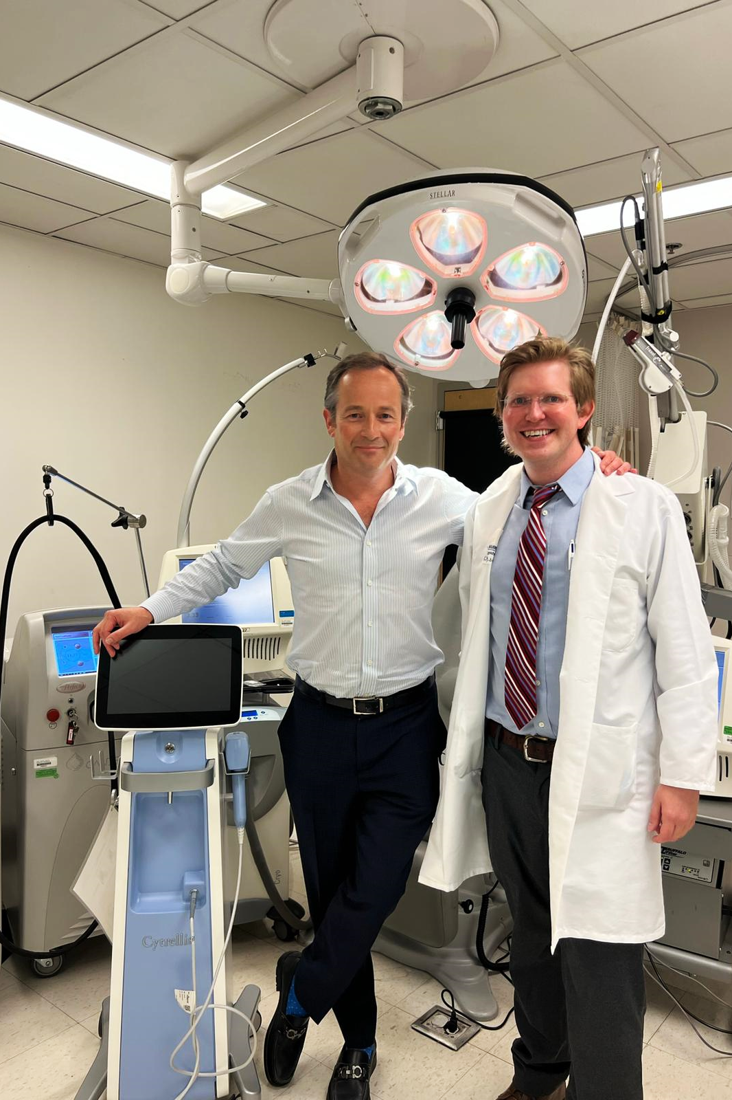
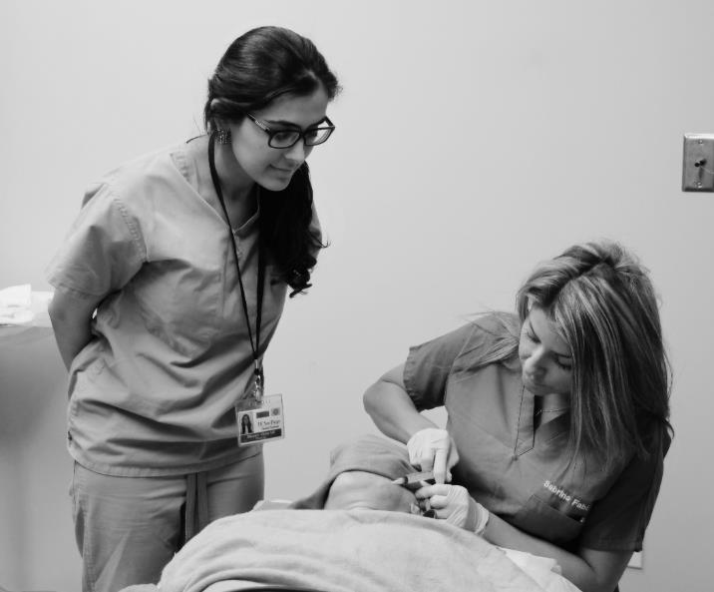
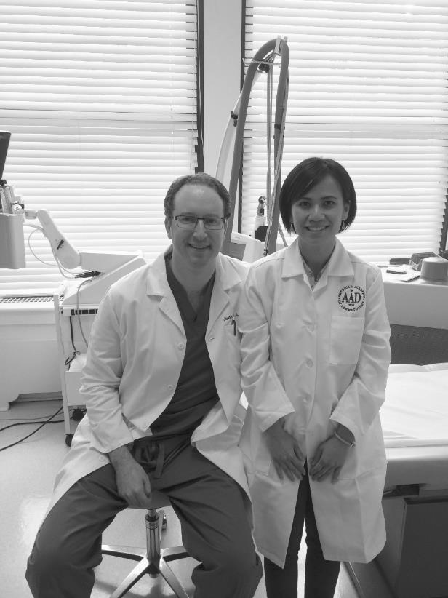
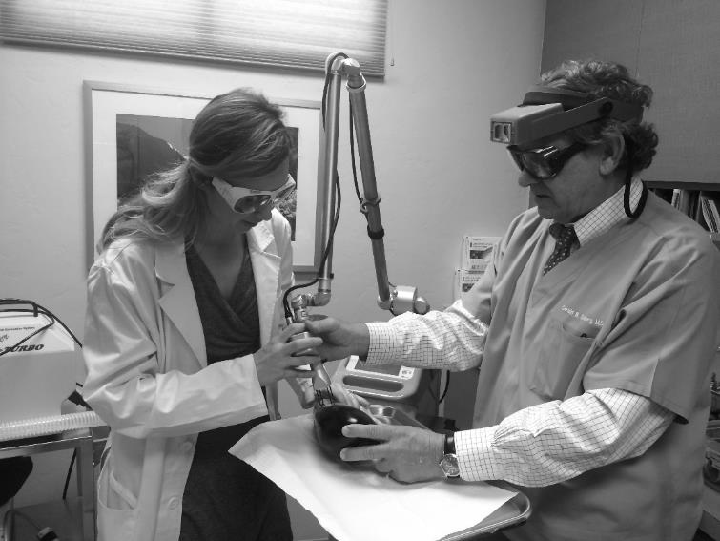
Education
Supported by an independent educational grant from AbbVie.
Preceptorship Program
Thank you to our Preceptorship Program supporter:

Slide 14
Education
Visiting Expert Program
The program matches laser and energy-based device experts with educational institutions to provide lectures on cutting-edge research, device innovations, best practices, complications and safety
At no cost, an institution can add a virtual or in-person laser and energy-based device teaching segment to their curriculum

Slide 15
research
Research Grants
ASLMS annually awards research grants designed to foster the development and use of lasers and other energy-based technologies in medical and surgical applications.
Who Qualifies?
ASLMS Member who is enrolled in or has completed post-doctoral and/or residency training within 7 years
Student Research Grants
As many as four student grants of $5,000 each may be awarded each year.
Undergraduate, Graduate Students (including Residents and Fellows)
Who Qualifies?

Slide 16
RESEARCH
Lasers in Surgery and Medicine Journal
Members receive a FREE online subscription to the scientific and clinical journal, Lasers in Surgery and Medicine - the official journal of the Society.
Lasers in Surgery and Medicine appears eleven times each year, including a special abstract issue for the ASLMS Annual Conference

Slide 17
NETWORKING
Early Career Network Online
Social Media
Website Keep up-to-date on Early Career resources at aslms.org.
Who Qualifies?
All ASLMS Members

Slide 18
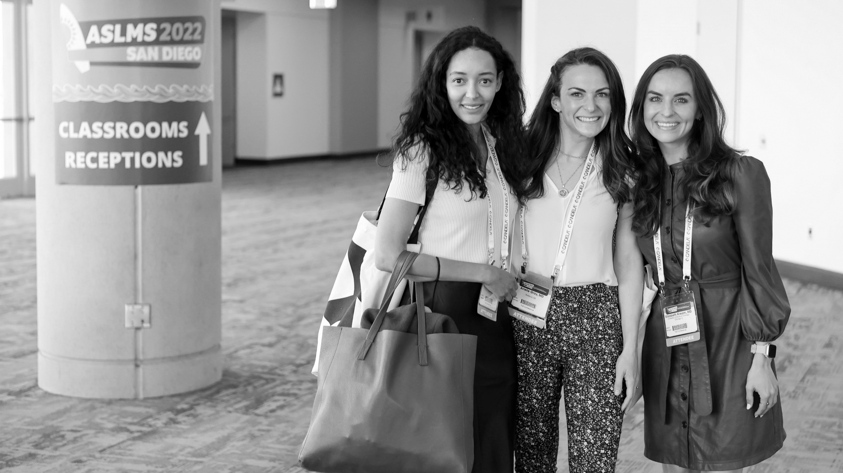
NETWORKING
Member-Get-A-Member
Refer colleagues for membership and earn rewards that you can apply to dues or reduce the cost of conference or course registration!
Who Qualifies?
ASLMS Members

Slide 19
PROFESSIONAL DEVELOPMENT
Who Qualifies?
All ASLMS Members
ASLMS Career Center
Post your resume, search jobs, and take advantage of our career resources to help you on your path to success! Receive free Preferred Resume placement!

Slide 20
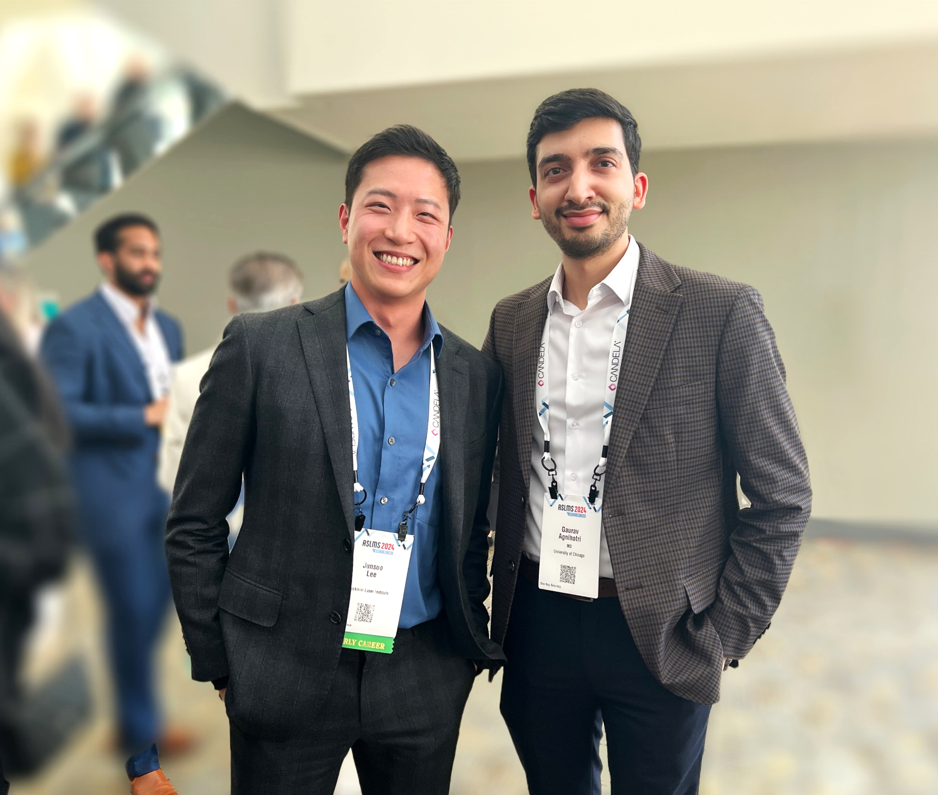
leadership
Student Board Positions
Four Student Board Representative (two resident/fellow, two early career scientist) positions on the Board of Directors offer practical non-profit, non-voting board leadership experience and opportunities to receive mentoring from established leaders.
Applications open each year in August.
ASLMS Member who is currently enrolled in a residency program or fellowship (resident/fellow), or masters, PhD or post-doctoral program (scientist)
Who Qualifies?

Slide 21
leadership
Resident Liaisons
Appointed to share information about ASLMS with their programs
A great opportunity to provide ideas and feedback, plus connect with peers and key Society leaders.
Who Qualifies?
ASLMS Member enrolled in a residency program during the appointed term

Slide 22
leadership
Committees
Select committees are open to volunteers
Call for volunteers opens each year in September
ASLMS COMMITTEES
Who Qualifies?
ASLMS Members

Slide 23
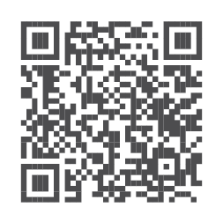
FOR MORE INFORMATION AND TO Join ASLmS…
Visit aslms.org
Call us at 1-877-258-6028

