Slide 1
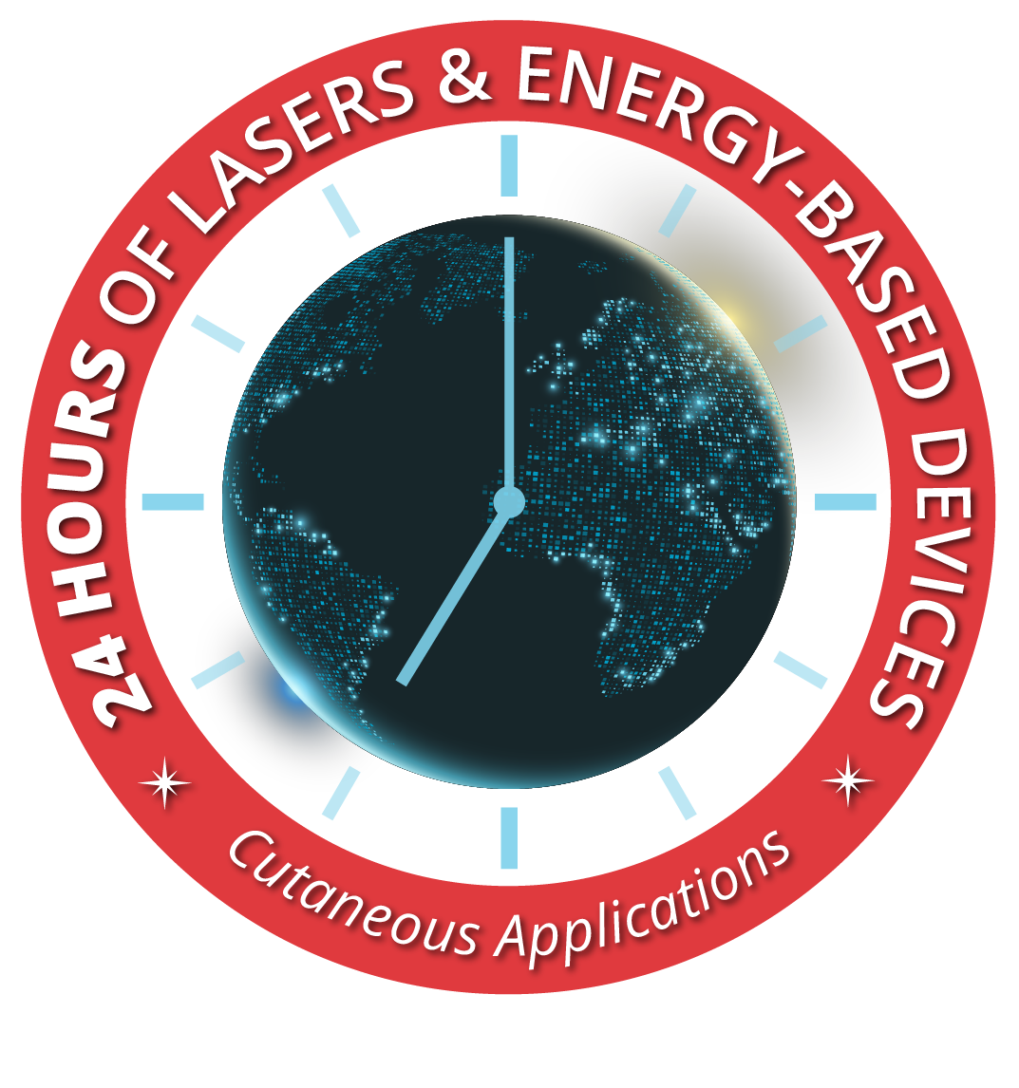
The premier global 24-hour event featuring leaders in the field of energy-based medicine. Leading experts from around the world will present the latest in laser and energy-based device clinical applications for dermatology. FREE for ASLMS members!
Learn more and register:
aslms.org/24hoursoflasers

