Slide 1


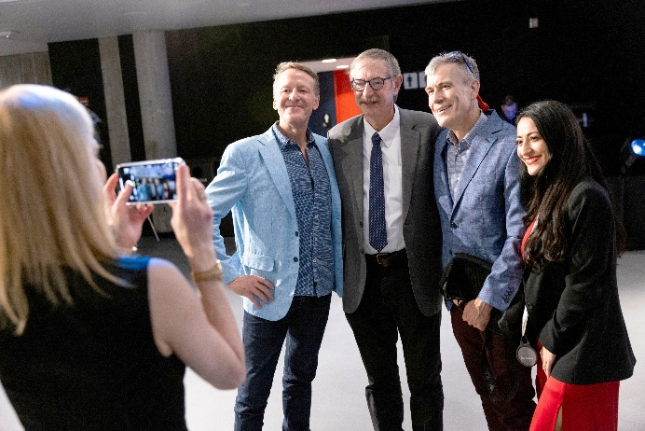
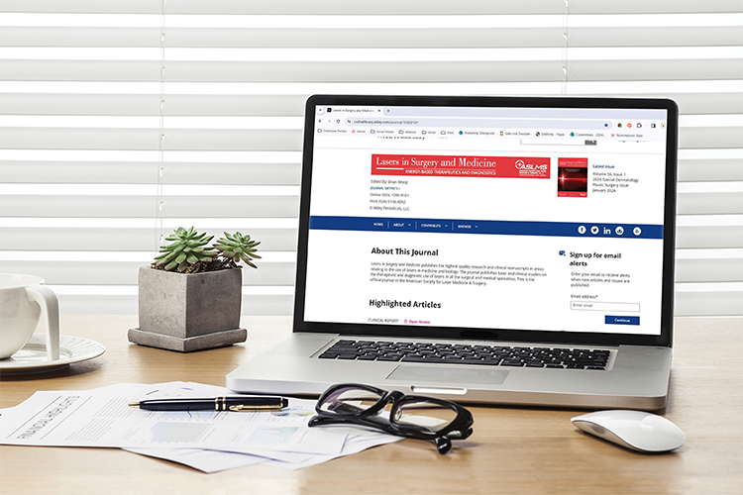
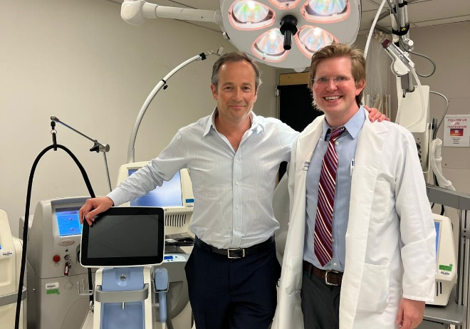
NETWORKING
with key thought leaders
driving the future of lasers
and energy-based devices
in medicine.
The world’s largest professional organization dedicated to promoting excellence in patient care through the safe and effective
use of lasers and
other energy-based technologies.
KNOWLEDGE
of the latest research, procedures, and protocols through the Society’s journal, Lasers in Surgery and Medicine, social media, and newsletters.
PROFESSIONAL DEVELOPMENT
via in-person and online resources offering a wide range of valuable educational opportunities.
JOIN TODAY!
aslms.org

Slide 2


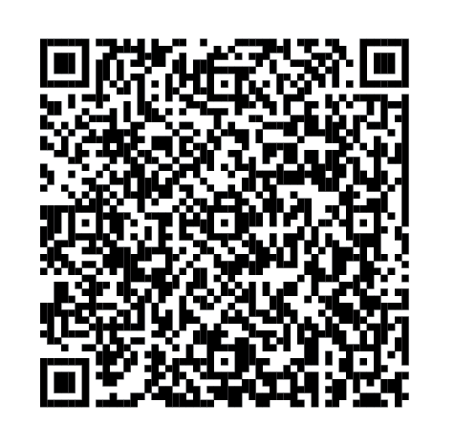
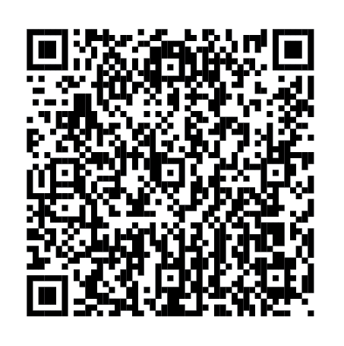
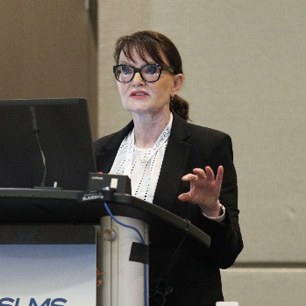
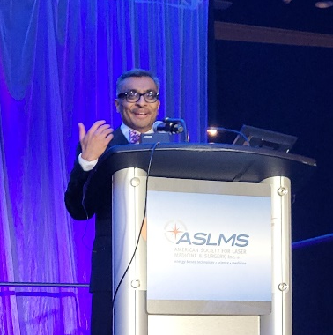
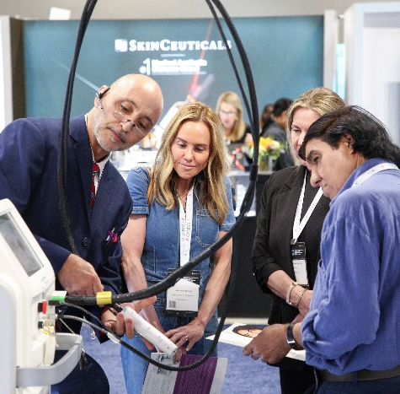
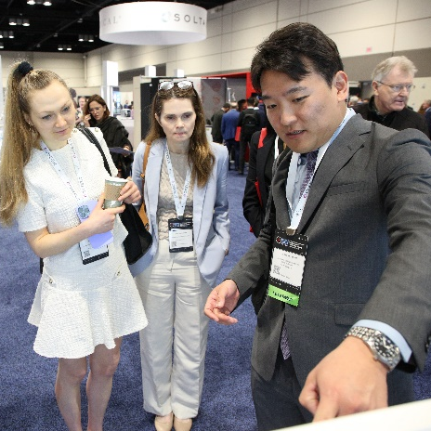

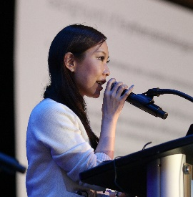
Join innovative clinicians and scientists from around
the world in Savannah, Georgia, at the premier
international meeting in the field of medical lasers
and energy-based technologies.
Members save on registration!
^{LEARN MORE}
^{ASLMS.ORG}
^{JOIN TODAY!}
^{ASLMS.ORG/JOIN}
^{CONFERENCE FEATURES}
^{KEY DATES}
Pre-Conference Courses
Continuing Education Credits
Industry Sessions
Workshops
Abstract Sessions
Daily Plenary Sessions
Special Events
Evening Receptions
Exhibit Hall
Call for Abstracts | SEP 17 - DEC 10, 2025
Pre-Conference | MAY 6, 2026
Conference | MAY 7-9, 2026
Exhibits | MAY 8-9, 2026
LEARN FROM THE WORLD’S LEADING EXPERTS ABOUT:
Ablative and
Non-Ablative Lasers
AI in Aesthetics
Body Contouring
Challenging Cases
Combining Modalities
Global Aesthetics
Hair Restoration
Laser Safety
Laser Physics
Laser-Assisted Drug Delivery
LLLT/Photobiomodulation
Optimizing Outcomes
Periorbital Rejuvenation
Picosecond Lasers
Pigmented Lesions
Practice Management
Radiofrequency
Regenerative Medicine
Rejuvenation
Scar Treatment
Skin Cancer
Skin of Color
Social Media
Tattoos
Ultrasound
Vascular
& More!

Slide 3

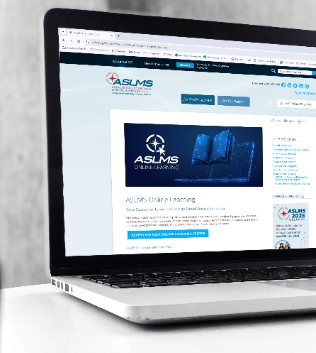
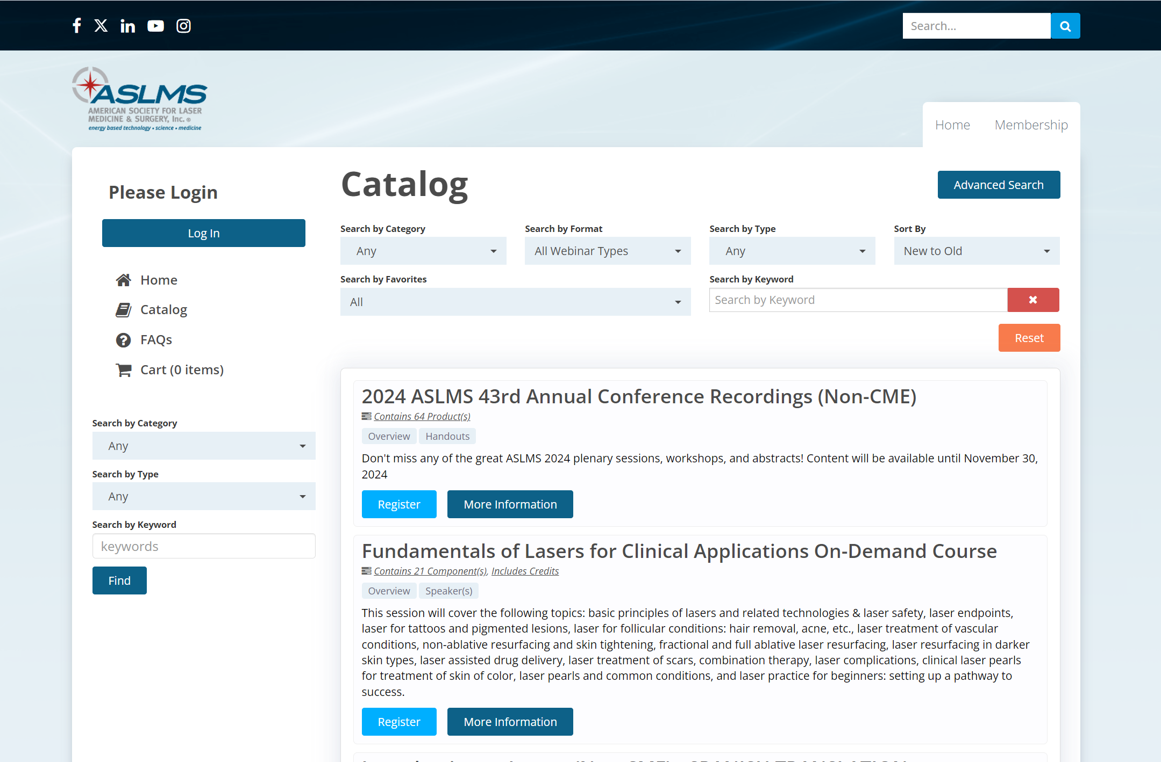
ASLMS BRINGS EDUCATION TO YOU
The ASLMS Online Learning Center features online courses and sessions presented by leaders in the field. Many of the offerings are free or at reduced rates for ASLMS members.
Learning is a lifelong journey. The ASLMS Online Learning Center is here to help!
Learn from the experts and get the training you need on your schedule.
ENHANCE YOUR PROFESSIONAL DEVELOPMENT WITH VALUABLE RESOURCES
On-Demand Courses
Annual Conference Recordings
Professional Resources
And more!
LEARN MORE AT
aslms.org/online-learning

