Slide 1


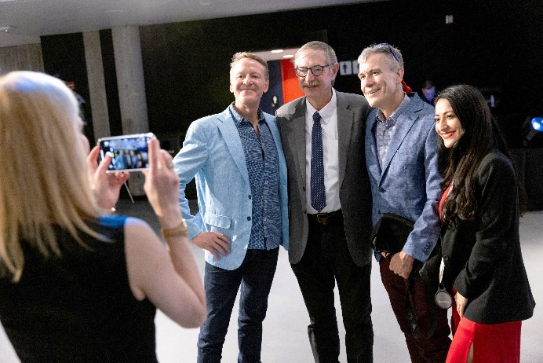
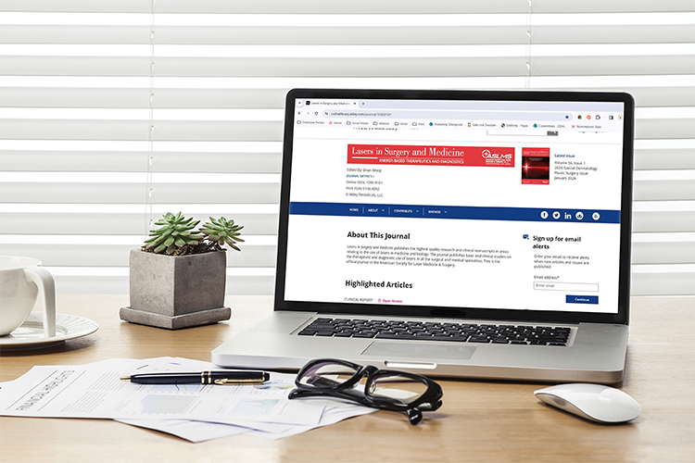
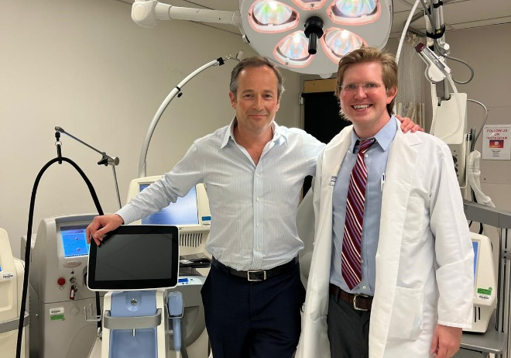
NETWORKING
with key thought leaders
driving the future of lasers
and energy-based devices
in medicine.
The world’s largest professional organization dedicated to promoting excellence in patient care through the safe and effective
use of lasers and
other energy-based technologies.
KNOWLEDGE
of the latest research, procedures, and protocols through the Society’s journal, Lasers in Surgery and Medicine, social media, and newsletters.
PROFESSIONAL DEVELOPMENT
via in-person and online resources offering a wide range of valuable educational opportunities.
JOIN TODAY!
aslms.org

Slide 2


^{CONFERENCE FEATURES}
Pre-Conference Courses
Continuing Education Credits
Industry Sessions
Workshops
Abstract Sessions
Daily Plenary Sessions
Special Events
Evening Receptions
Exhibit Hall
^{KEY DATES}
Join innovative clinicians and scientists from around the world
in Orlando, Florida, at the
premier international meeting
in the field of medical lasers
and energy-based technologies.
Call for Abstracts | AUG 19 - NOV 4, 2024*
Late Breaking Abstracts | NOV 11, 2024 - JAN 13, 2025*
Pre-Conference | APR 23, 2024
Conference | APR 24-26, 2024
Exhibits | APR 25-26, 2024
*Submission deadlines end at 11:59 AM CST
LEARN FROM THE WORLD’S LEADING EXPERTS ABOUT:
Body Contouring
Combining Injectables with Devices
Complications and Legal Issues
Dental
Face and Body Lifting/Tightening
Imaging
Hair Growth
Laser Safety
Laser-Assisted Drug Delivery
Pediatrics
Photobiomodulation
Photodynamic Therapy
Pigmented Lesions
Practice Management
Rejuvenation
Resurfacing
Scar Treatment
Skin Cancer
Skin of Color
Social Media
Tattoo Removal
Vascular
Women’s Health
& More!
^{LEARN MORE | ASLMS.ORG}

Slide 3

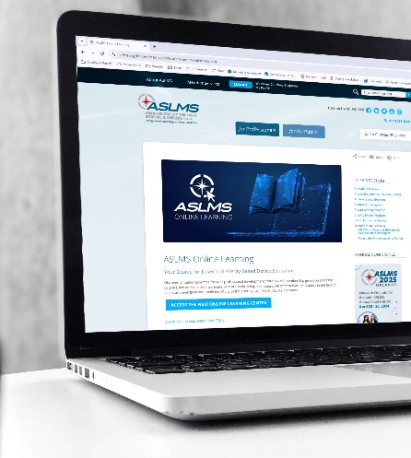
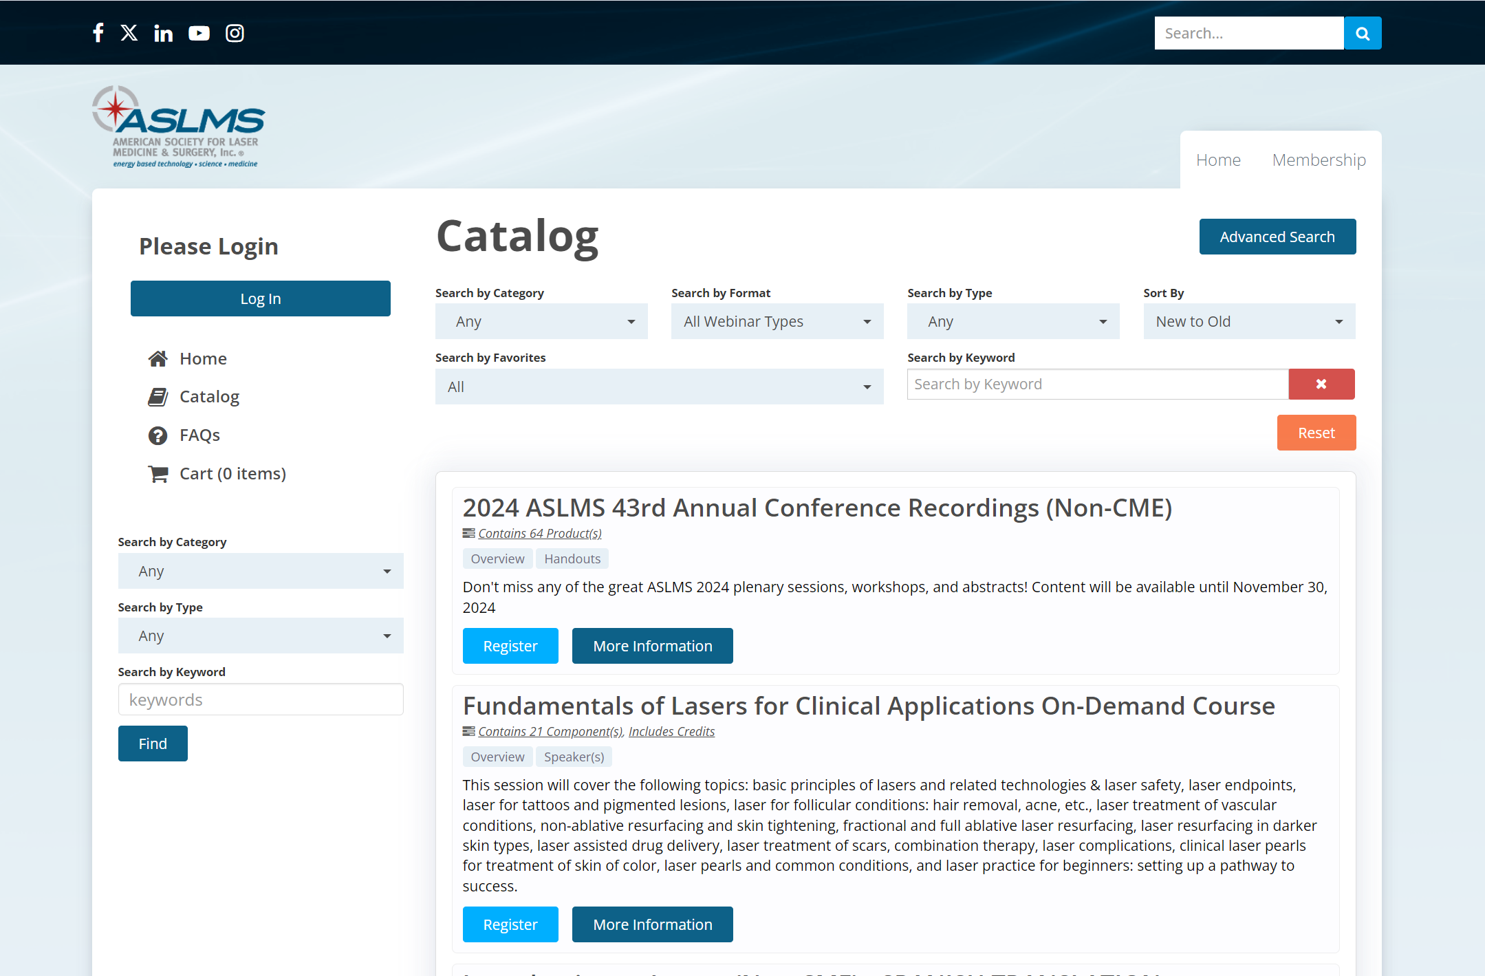
ASLMS BRINGS EDUCATION TO YOU
The ASLMS Online Learning Center features online courses and sessions presented by leaders in the field. Many of the offerings are free or at reduced rates for ASLMS members.
Learning is a lifelong journey. The ASLMS Online Learning Center is here to help!
Learn from the experts and get the training you need on your schedule.
ENHANCE YOUR PROFESSIONAL DEVELOPMENT WITH VALUABLE RESOURCES
On-Demand Courses
Annual Conference Recordings
Professional Resources
And more!
LEARN MORE AT
aslms.org/online-learning

